Slide 1
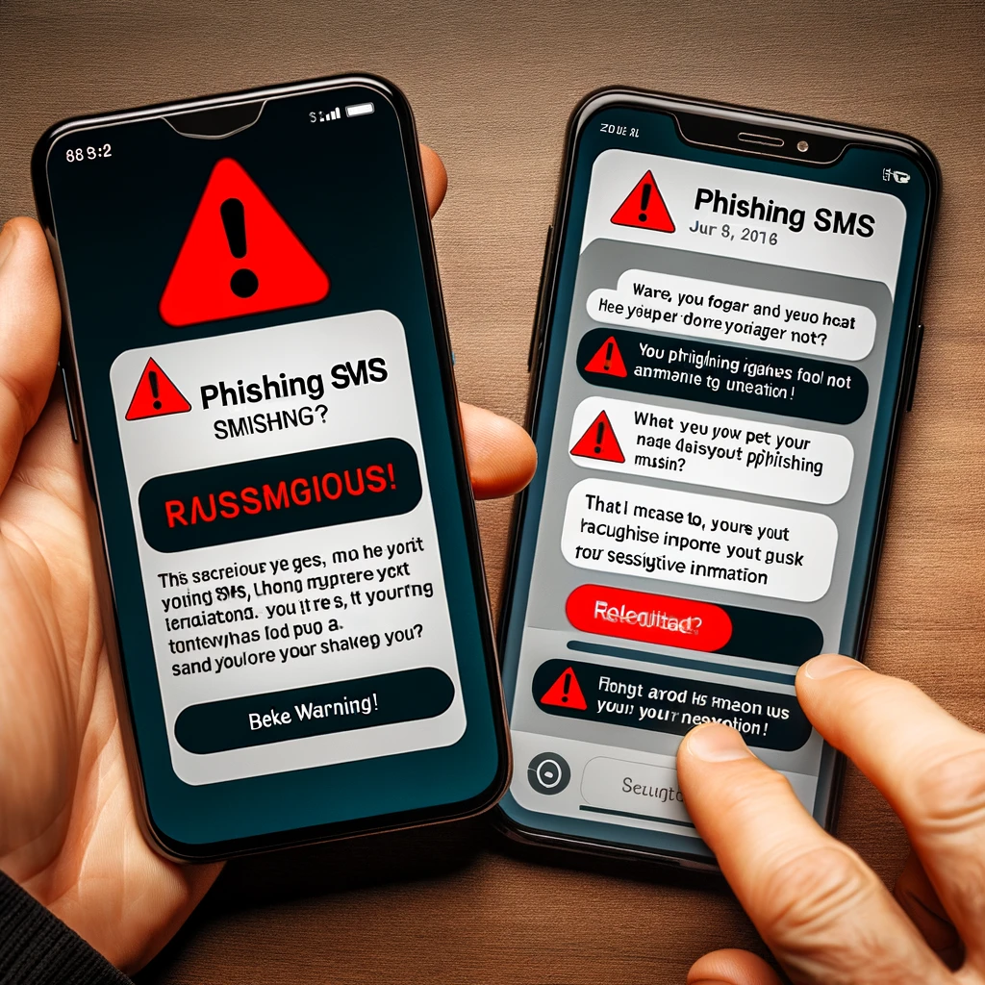
PHISHING AWARENESS TRAINING
Protect Yourself from Cyber Threats

Slide 2
Introduction to Phishing
What is Phishing?
Definition: Phishing is a cyberattack in which attackers attempt to deceive individuals into sharing sensitive information, often via email, websites, or text messages.
Goal: Steal personal information like usernames, passwords, or credit card details.
Types of Phishing: Email phishing, website phishing, spear-phishing, and social engineering tactics.

Slide 3
Types of Phishing Attacks:
Email Phishing: Sending fraudulent emails that appear legitimate.
Website Phishing: Creating fake websites that mimic real ones to capture sensitive data.
Spear Phishing: Targeting specific individuals with tailored content to increase success rates.
Smishing and Vishing: Phishing through SMS (Smishing) or voice calls (Vishing).

Slide 4
How Phishing Works:
The Process:
Attacker sends a deceptive message.
Victim clicks a malicious link or downloads an attachment.
The victim enters personal information on a fraudulent website.
The attacker gains access to sensitive data.
Common Phishing Tactics:
Urgency or fear (e.g., “Your account will be locked if you don’t act now!”)
Posing as trusted entities (e.g., bank, social media platform, government agency).

Slide 5
Recognizing Phishing Emails:
Key Indicators:
Suspicious Sender: Unknown email addresses, slight variations in domain names.
Unfamiliar Links: Hover over links to check the URL before clicking.
Grammatical Errors: Legitimate organizations tend to have professional communication.
Urgent Language: Claims that your account is compromised or requires immediate action.
Unexpected Attachments: Especially ZIP files or EXE files.

Slide 6
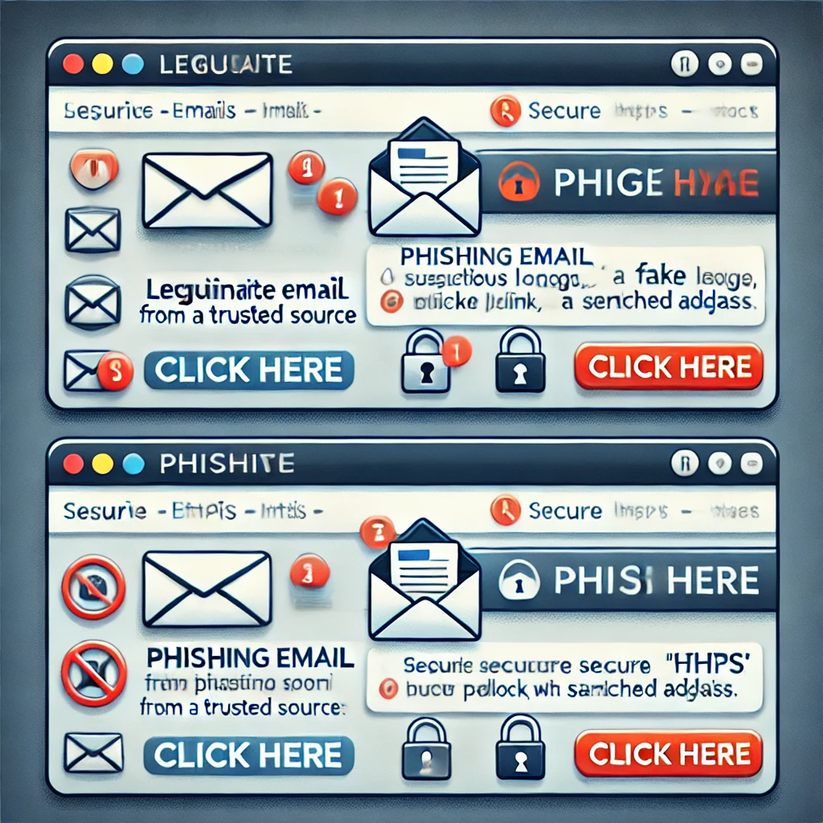
Phishing Websites:
How to Spot a Fake Website:
Check the URL: Look for slight variations in the spelling or domain.
SSL Certificate: Legitimate sites use HTTPS. Be cautious of sites without the padlock symbol.
Visual Clues: Low-quality logos or images, spelling errors, odd formatting.
Example:
Real Website:
URL: https://www.bankofexample.com
Fake Website:
URL: http://www.bankofexammple.com

Slide 7
Social Engineering Tactics:
What is Social Engineering?
Definition: Manipulating people into divulging confidential information.
Tactics:
Pretexting: Pretending to be someone trustworthy (e.g., tech support).
Baiting: Offering something enticing to make a victim act (e.g., free downloads).
Tailgating: Physically following someone into a restricted area.
Real-World Example: In 2016, a phishing attack on the Democratic National Committee (DNC) used social engineering to trick staff into revealing their credentials, leading to a major email leak during the U.S. Presidential election.

Slide 8
Best Practices to Avoid Phishing Attacks:
Email Hygiene:
Do not click on suspicious links or open unexpected attachments.
Verify the sender’s email address.
Avoid sharing personal information via email.
Website Safety:
Double-check URLs, especially for login pages.
Never enter personal information on sites that don't have HTTPS.
Additional Precautions:
Use Two-Factor Authentication (2FA).
Keep your software and antivirus updated.
Report phishing attempts to your IT or security department.

Slide 9
Case Study: Famous Phishing Attack:
Example: The 2016 DNC Email Phishing Incident
What Happened: Hackers sent fraudulent emails to members of the Democratic National Committee.
Outcome: Sensitive data was stolen, leading to political repercussions.
Lessons Learned: Highlight the importance of vigilance and verification.

Slide 10

Conclusion and Call to Action:
Summary: Phishing attacks are common but avoidable. Stay vigilant, educate others, and protect your sensitive information.
Call to Action: Share this training with colleagues and report any suspicious messages or websites to your security team.

